Slide 1
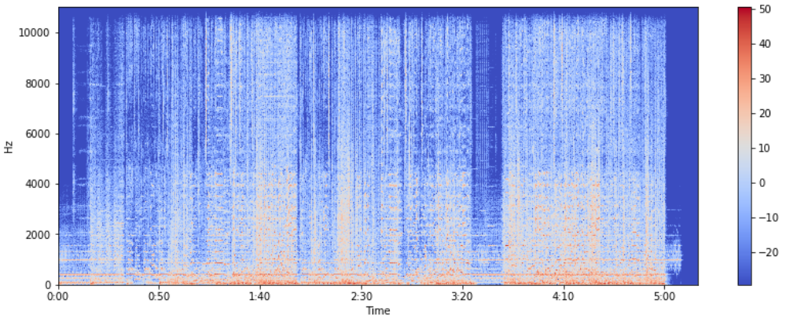

Instrument Recognition Software
Aleks
Aner
Axel
Cuong
Joe
Thomas
Hmm, that might be a guitar...

Slide 2
Business Requirements Document
We did not have any significant updates in our BRD

Slide 3
Management Plan
We have updated our Sprint Board and Burndown Chart

Slide 4

Architecture and Design
UPDATES:
Primary Data Source
Philharmonia Orchestra
The website was recently overhauled
The audio files we are working with might have been removed or updated
Cross-referencing the audio files can take some time
If the audio files are indeed updated and is of better quality
Then we might need to re-do our sample data
Side project: Mobile application

Slide 5


Mobile Application
Looking at possibilities of a Mobile (Android) Application
Language: Java and XML
Server: Firebase
Currently, we have a very simple Login, Registration, and Welcome page
Repo: https://github.com/a-ner/irs-mobile
!!! SIDE PROJECT !!!
Full commitment on desktop application
Download link: bit.ly/2Tg6BrF

Slide 6
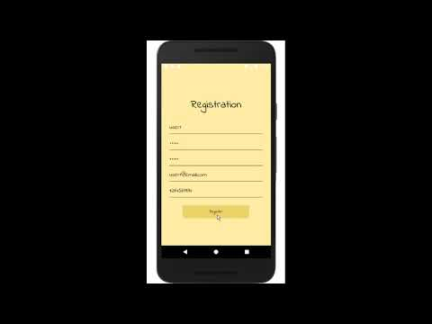

Mobile
Application Demo

Slide 7
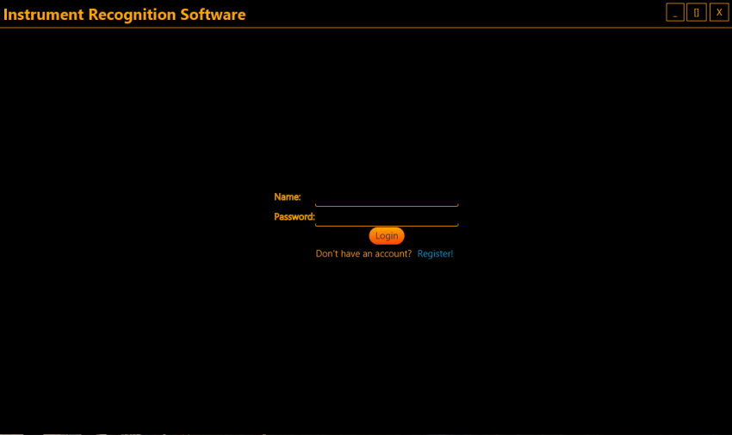
Desktop Preview

Slide 8
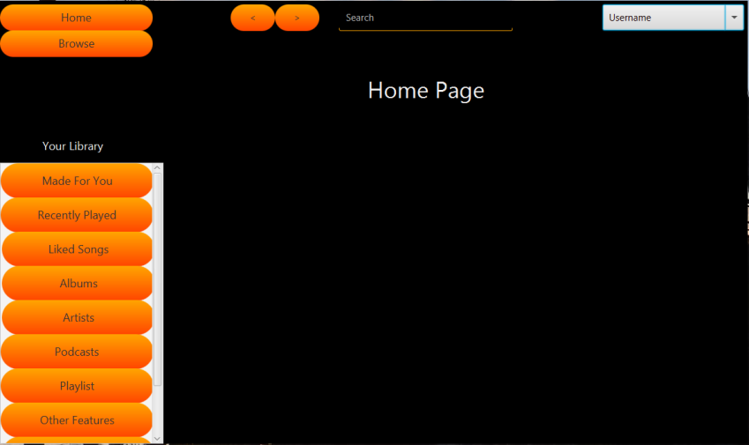
Potential Page Layout

Slide 9
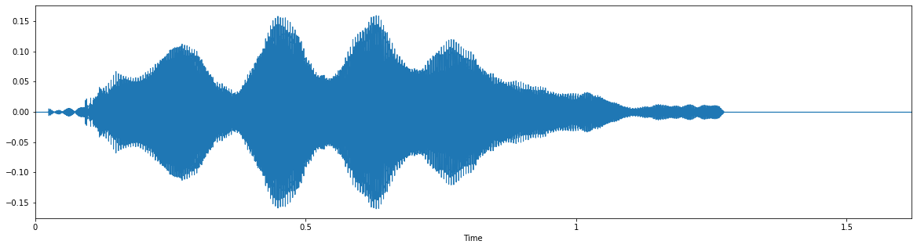
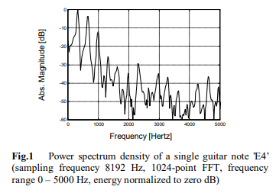
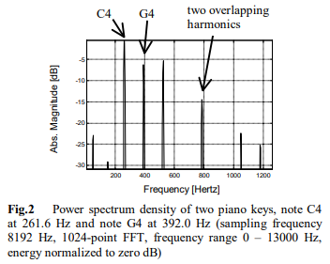

Input Data
FFT:
Power Spectral Density Graphs
Fast Fourier transform -> PSD
Divide into fundamentals (lower tones) and overtones (higher)

Slide 10
Batch Construction
Test Cases
3 labels
10 samples
3 labels
1000 samples
5 labels
1000
3 labels
100000
Compilation
Measures accurately
Accuracy improvement
Light strength test
Scalability
Intrafamilial differentiation
Pure strength test

Slide 11
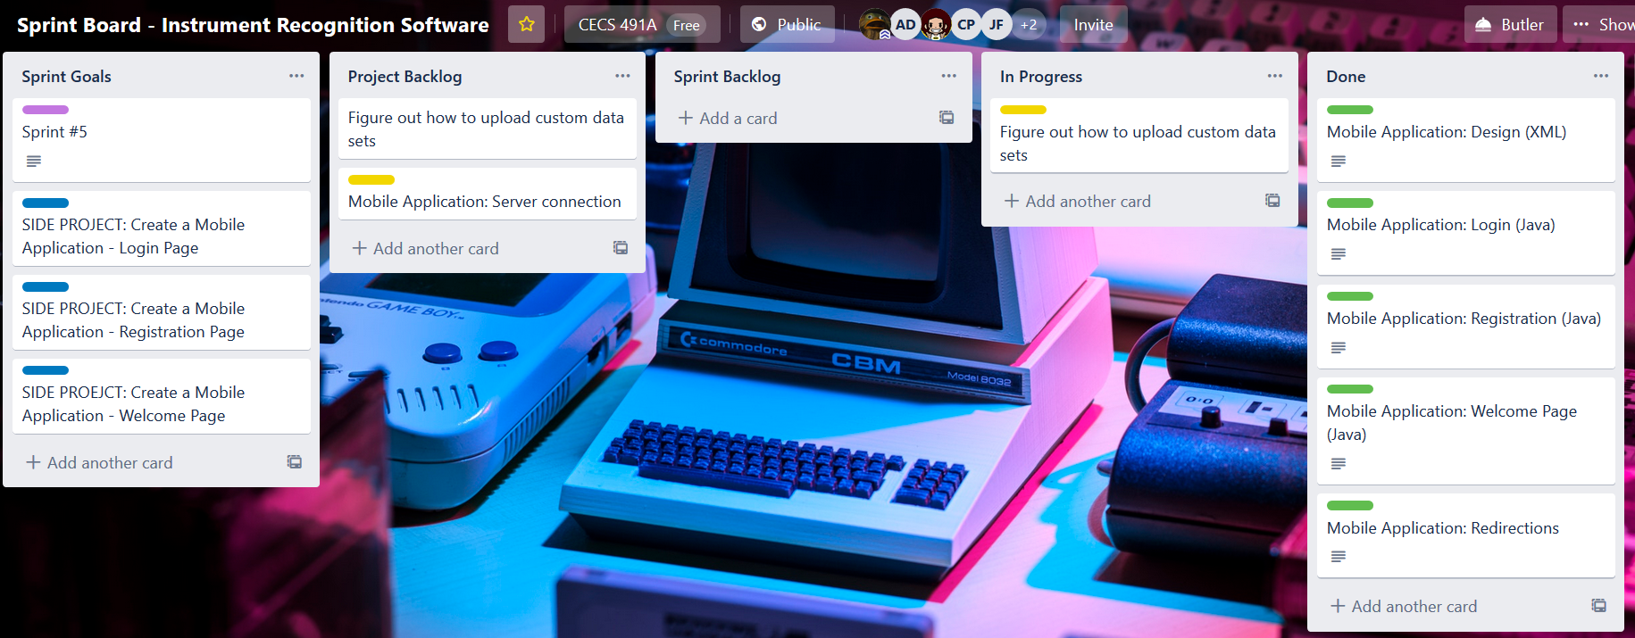
Sprint Board

Slide 12
Sprint Summary
This sprint our team was able to diversify our product presentation to showcase enterprise implementation. In addition to improving user-end devices we have mapped and scheduled white box testing of our preliminary IRS product.
Sprint Goal
Continue working on the ML
Side project: Android application
User Story Points
Planned: 30 hours
Achieved: 30 hours
Next Steps
First IRS model with proposed tests: March 18th

Slide 13
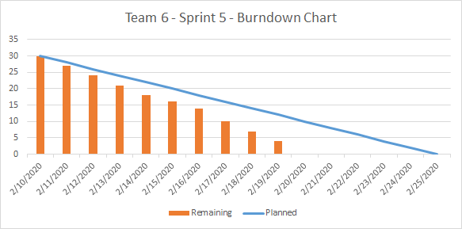
Burndown Chart

Slide 14

Thank you for listening!

